Slide 1

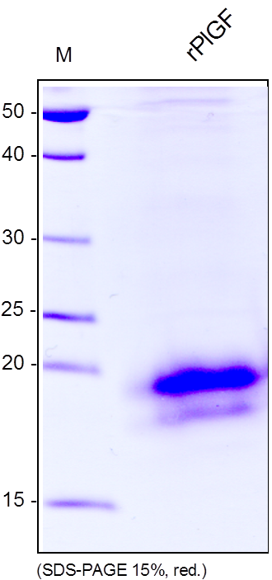
ReliaTech GmbH
Recombinant rat PlGF
(Cat #R20-061S / R20-061 / R20-062)
Fig. 1: SDS-PAGE analysis of recombinant rat PlGF derived from insect cells. Sample was loaded in 15% SDS-polyacrylamide gel under reducing conditions and stained with Coomassie blue.
http://www.reliatech.de / orders@reliatech.de

